Slide 1


Tri-Con
Preclinical Drug Discovery Hackathon
Reed Bender, Benafsh Husain Sapra, Ben Shealy, Jeannette Koschmann

Slide 2

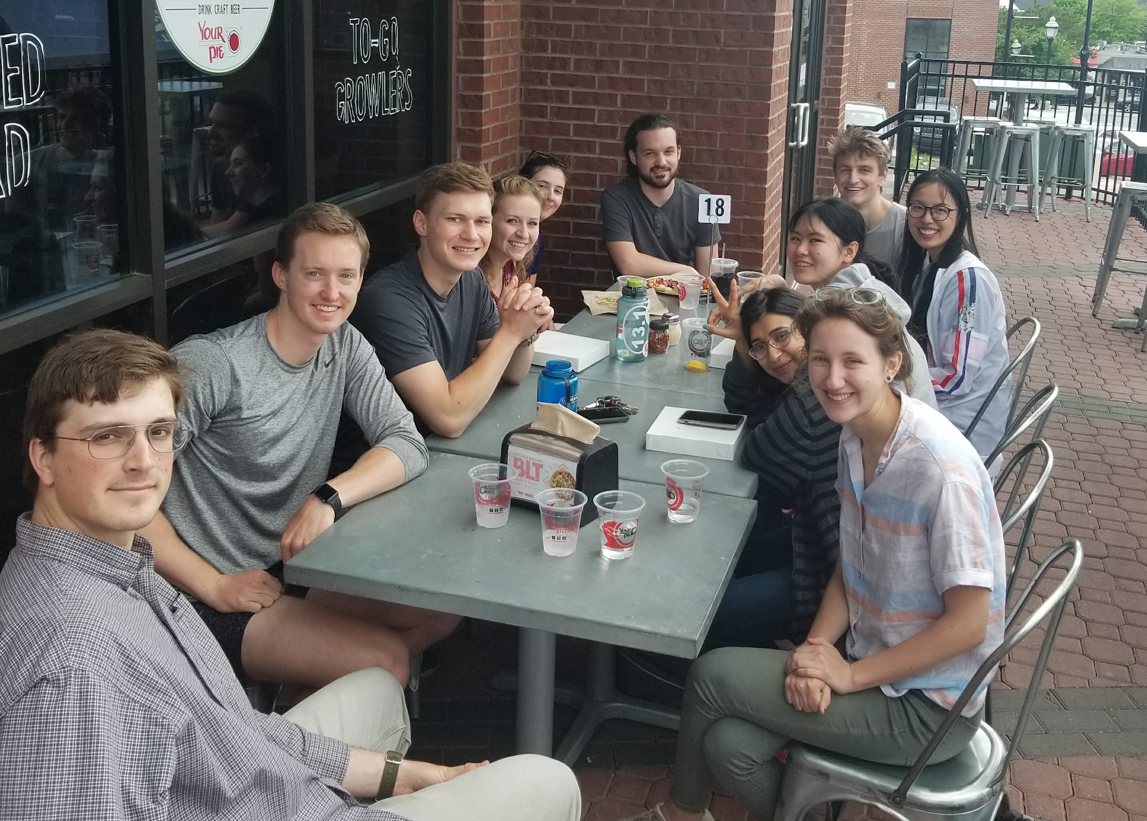
Who are we?
The Systems Genetics lab at Clemson
Reed Bender
M.S. Student in Biomedical Data Science and Informatics
Benafsh Husain Sapra
PhD Candidate in Biomedical Data Science and Informatics
Ben Shealy
PhD Candidate in Computer Engineering

Slide 3
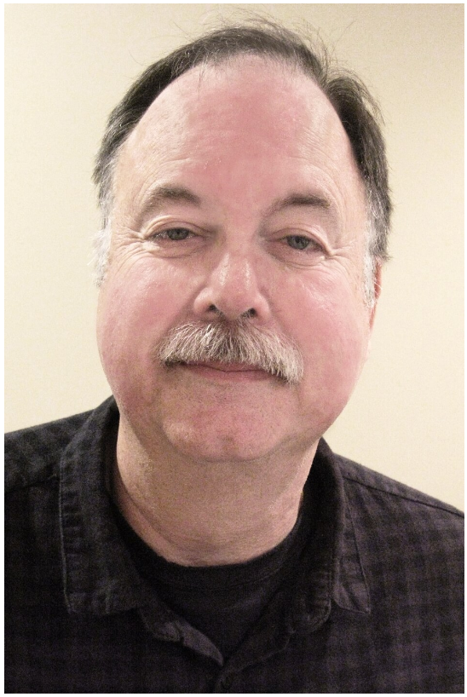
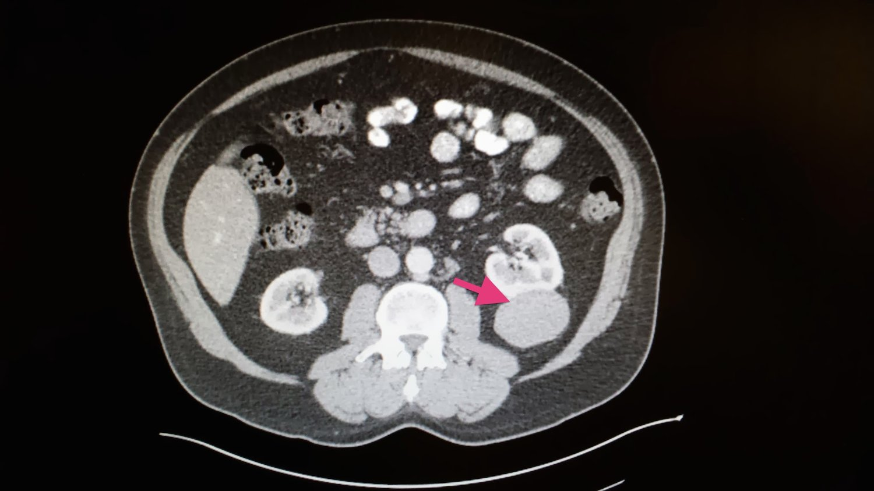
Who’s the Patient?
Tony Stark: “I shouldn’t do anything. They could kill you, they’re gonna kill me, either way, and even if they don’t, I’ll probably be dead in a week.”
Yinsen: “Then this is a very important week for you, isn’t it?”

Slide 4
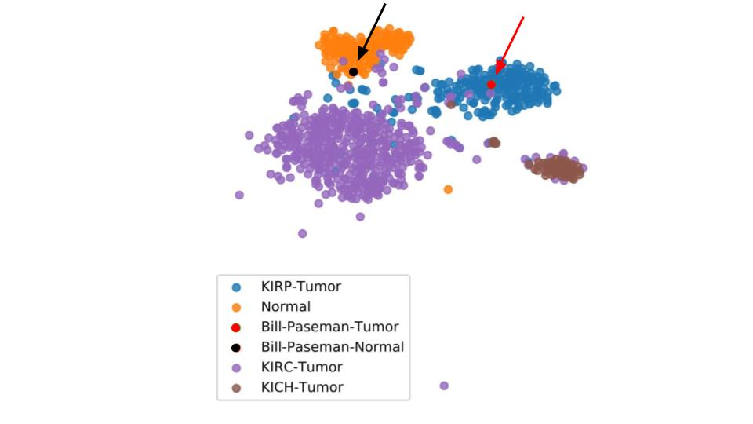
What do we have?
t-SNE Clustering of Unified RNA-sequencing data
Unified RNA-sequencing data
TCGA kidney cancer data (KIRP, KICH, KIRC)
GTEx normal tissue data
Bill Paseman’s tumor and normal RNAseq
Aligned BAM files with Bill Paseman’s tumor DNA sequences
Candidate gene lists for potential kidney-cancer specific aberrations

Slide 5
What are our goals?
Short-term Goals
Process the unified gene expression matrix to identify novel kidney cancer markers
Analyze candidate gene lists and relationships to search for potential targets
Identify potential therapeutics for those targets
Long-term Goals
Discover methods of comparing RNA-seq data with DNA
Test efficacy of potential therapeutics
Create precision medicine centric pipeline to apply to a variety of cancers

Slide 6
Come talk to us!
Use our GEM and/or Bill’s RNA seq data
Find candidate genes to compare with ours
Talk to Bill Paseman

Slide 7
Workflow Diagram
RNA-seq Data
Training Data
-----------------
TCGA, GTEx
Testing Data
----------------
Patient tumor
Gene Oracle
Candidate Genes
Consensus Genes
Related Pathways
KINC
Candidate Genes
Therapeutic Targets
NetExtractor
Candidate Genes
TSPG
Candidate Genes
...
...

Slide 8
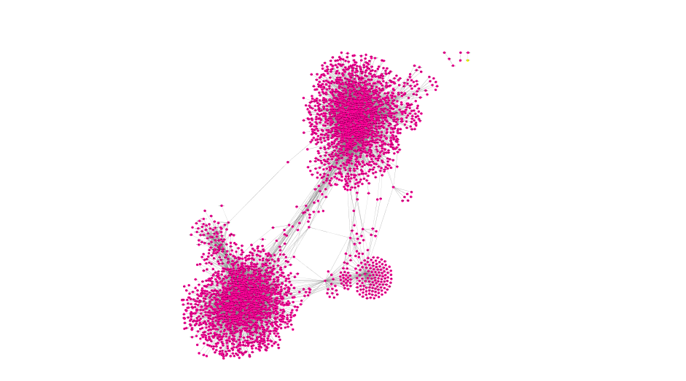
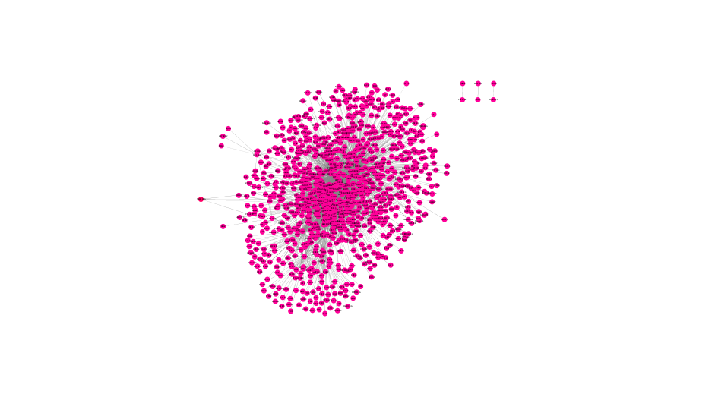
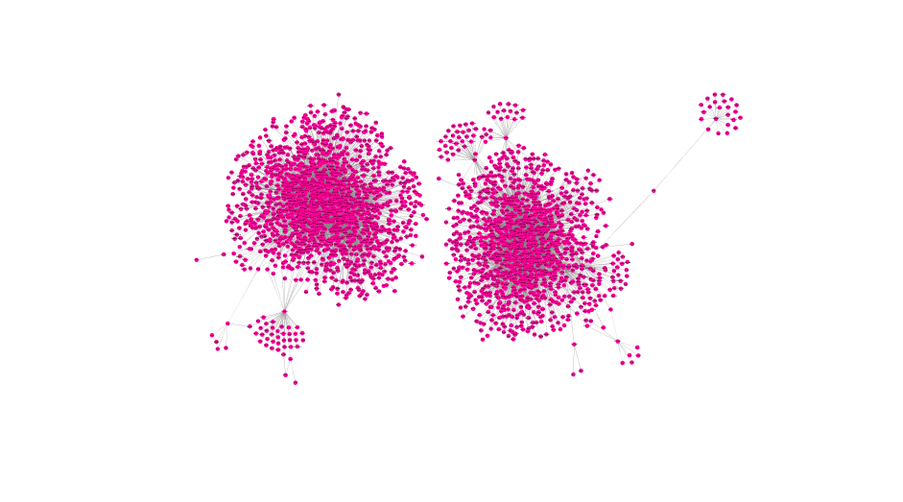
Gene Relationship Networks
Example Kidney RNAseq Network (EdgeCrafting)
Bill RNAseq Network (EdgeCrafting)
Up-regulated tumor samples
Down-regulated tumor samples

Slide 9
Workflow Diagram

Slide 10

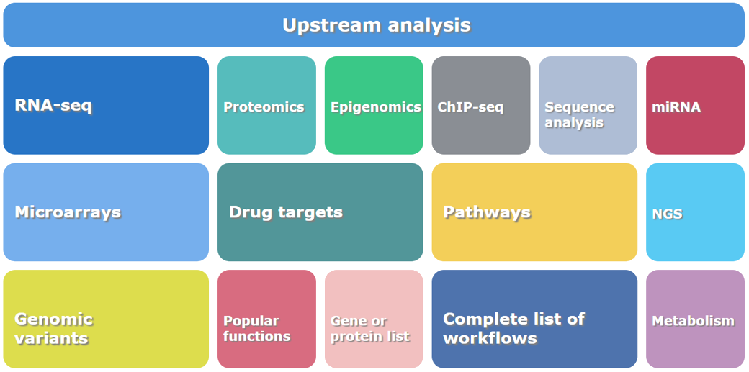
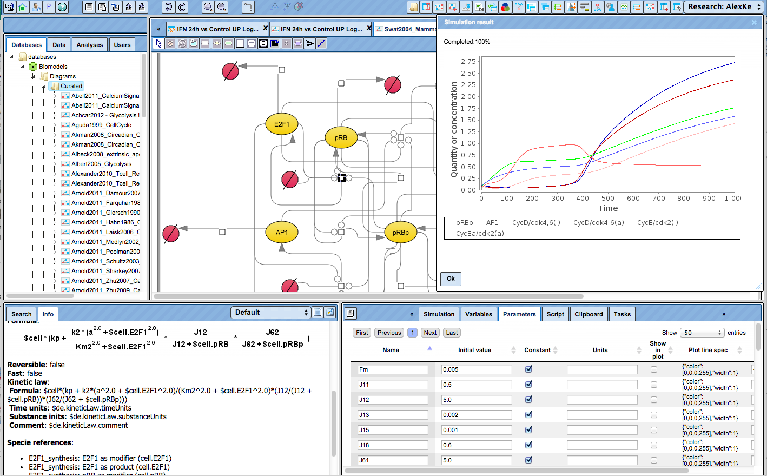
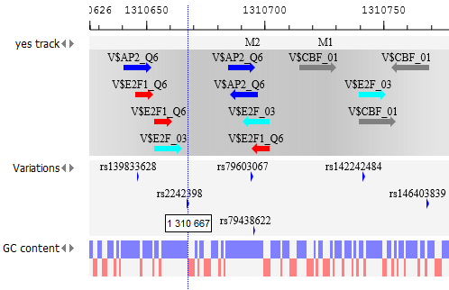
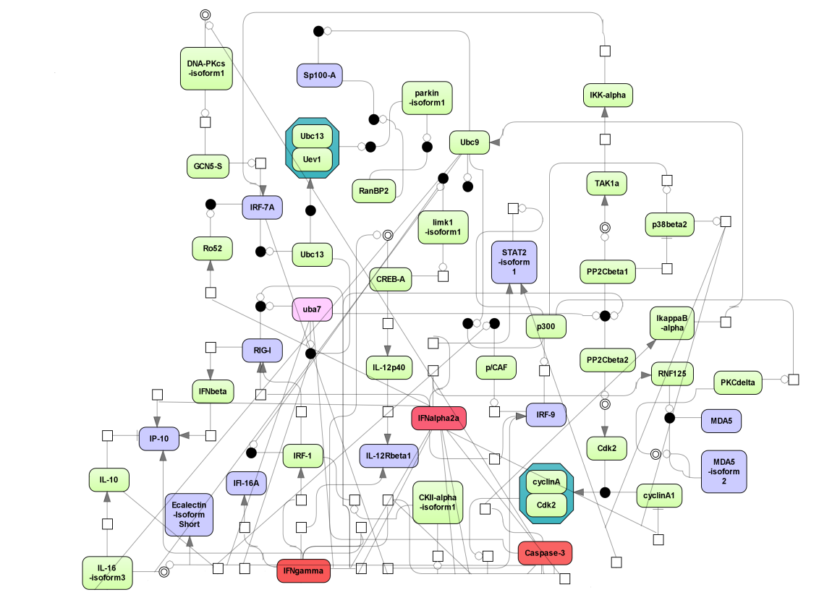
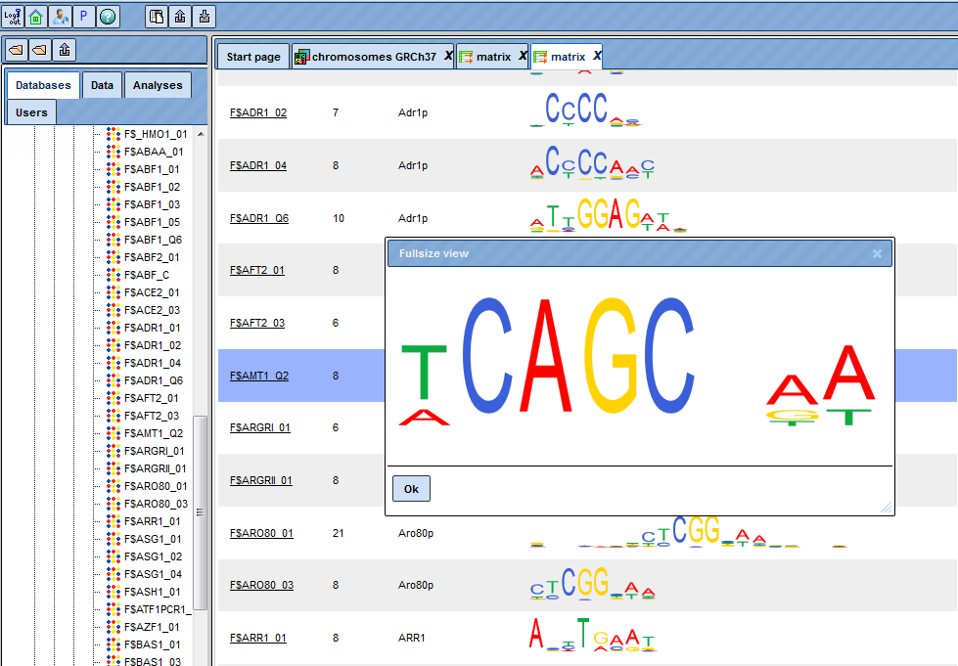
gene
plain
geneXplain platform
Tools
Key features
Integrated databases and analysis tools
Ready-made workflows for an easy start
Upstream analysis (integration of genome regulatory regions analysis with pathway analysis)
Knowledge-based data analysis
Group project work including chat function
JavaScript and R scripts for advanced users
Simulation engine inside

Slide 11
Search for master-regulators in signaling pathways
HumanPSD™
PASS
Master regulators
TRANSPATH®
TRANSFAC®
Transcription factors
Disease genes

Slide 12
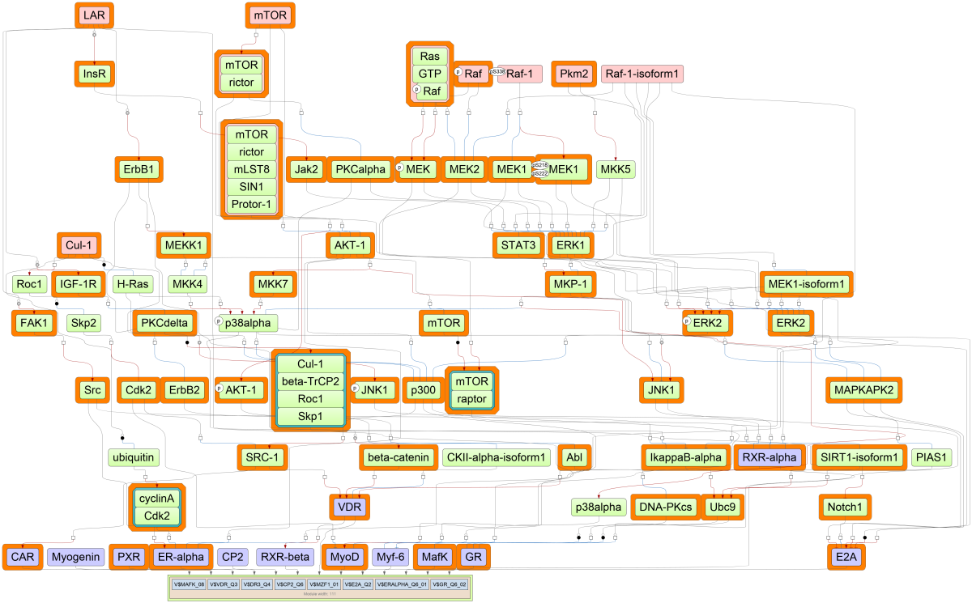
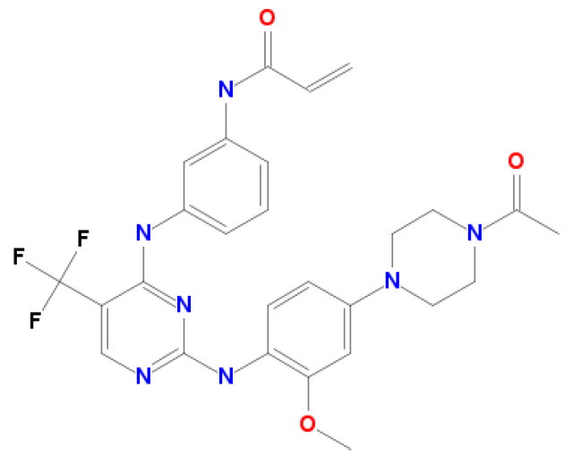
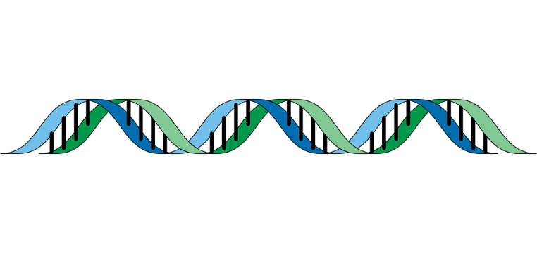
Upstream Analysis
HumanPSD™
PASS
Master regulators
Intermediate signaling molecules
TRANSPATH®
Cetuximab
Gefitinib
Transcription factors
TRANSFAC®
Genes
Genome
Notes:
Genome Enhancer uses geneXplain’s proprietary Upstream Analysis, an integrated promoter and
pathway analysis, to identify potential drug targets of the studied pathology. In the first step of this
analysis the transcription factors that regulate differentially expressed or mutated genes are identified
with the use of the TRANSFAC® database. The second step searches for common master-regulators of
the identified transcription factors by building a personalized signal transduction network of the studied
pathology using the TRANSPATH® database. The identified master regulators are prospective drug target
candidates and they are used for further selection of chemical compounds that can bring therapeutic
benefit for the studied clinical case. At this step the HumanPSD™ database is employed to identify drugs
which have been tested in clinical trials against the selected targets. Also the cheminformatic tool called
PASS is used to predict potential small molecules that can affect the identified targets.

Slide 13
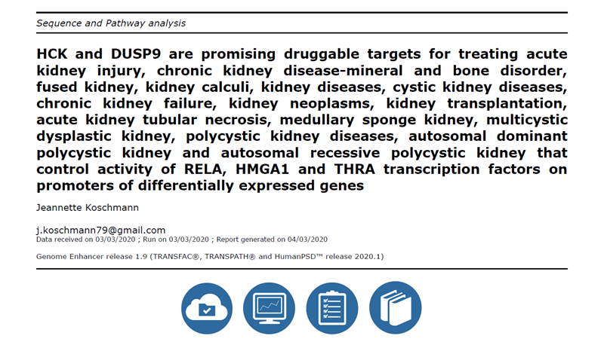

Slide 14

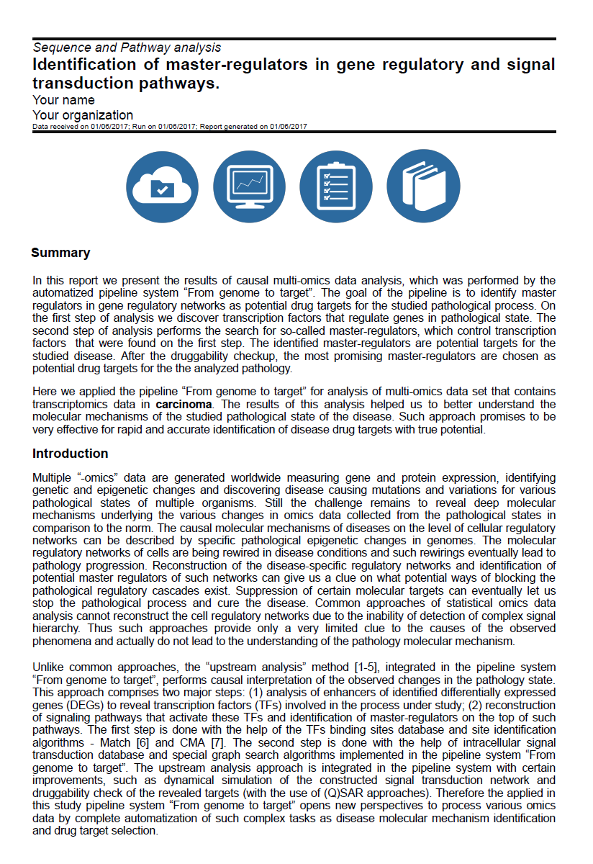
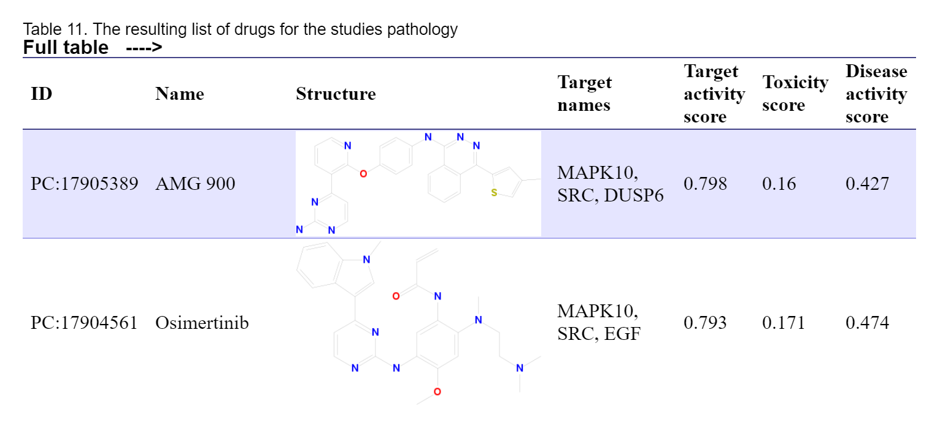

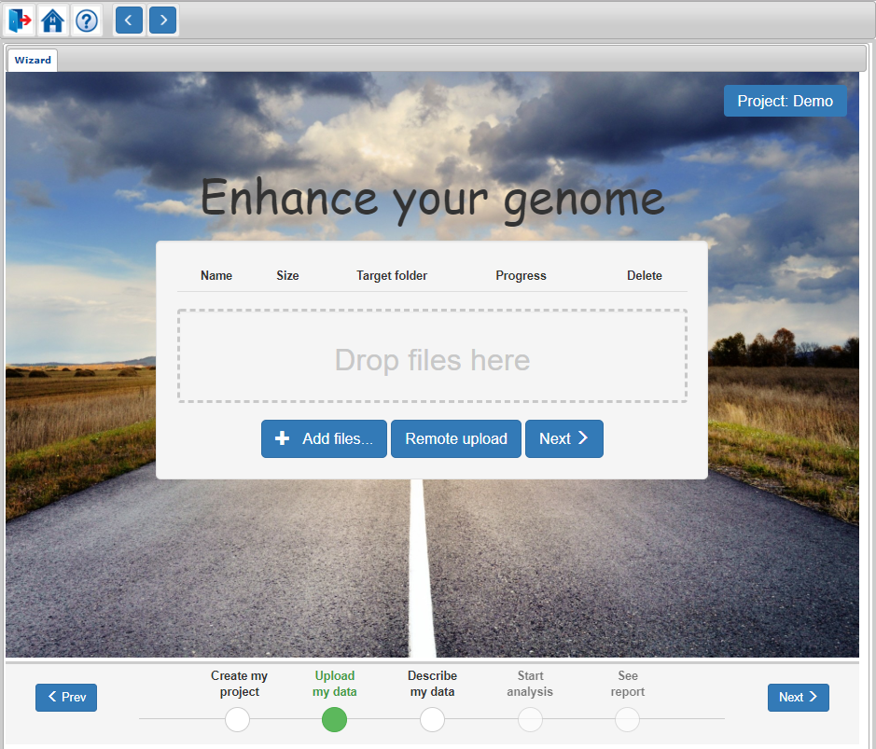
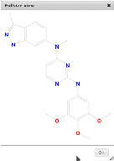
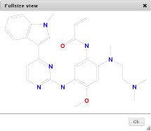
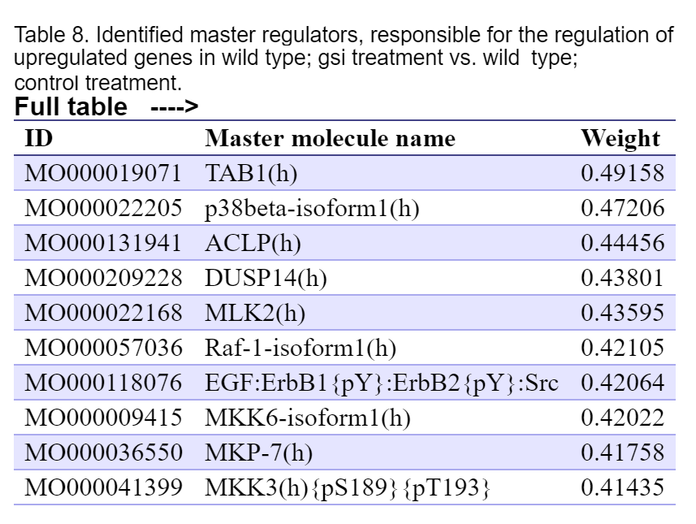
Genome Enhancer
gene
plain
Tools
Genome Enhancer is a ready-to-use pipeline for multi-omics data analysis, which allows completely automated identification of potential drug targets by running the Upstream analysis combined with search of corresponding perspective drug compounds.
A clear result, issued in the form of a finished publication
Suitable for direct use by physicians and biologists
Processes all types of omics data
Does not require special skills
Generates a ready report on the predicted therapeutic targets and drug compounds which inhibit them
Easy data upload and annotation
One-click run

Slide 15

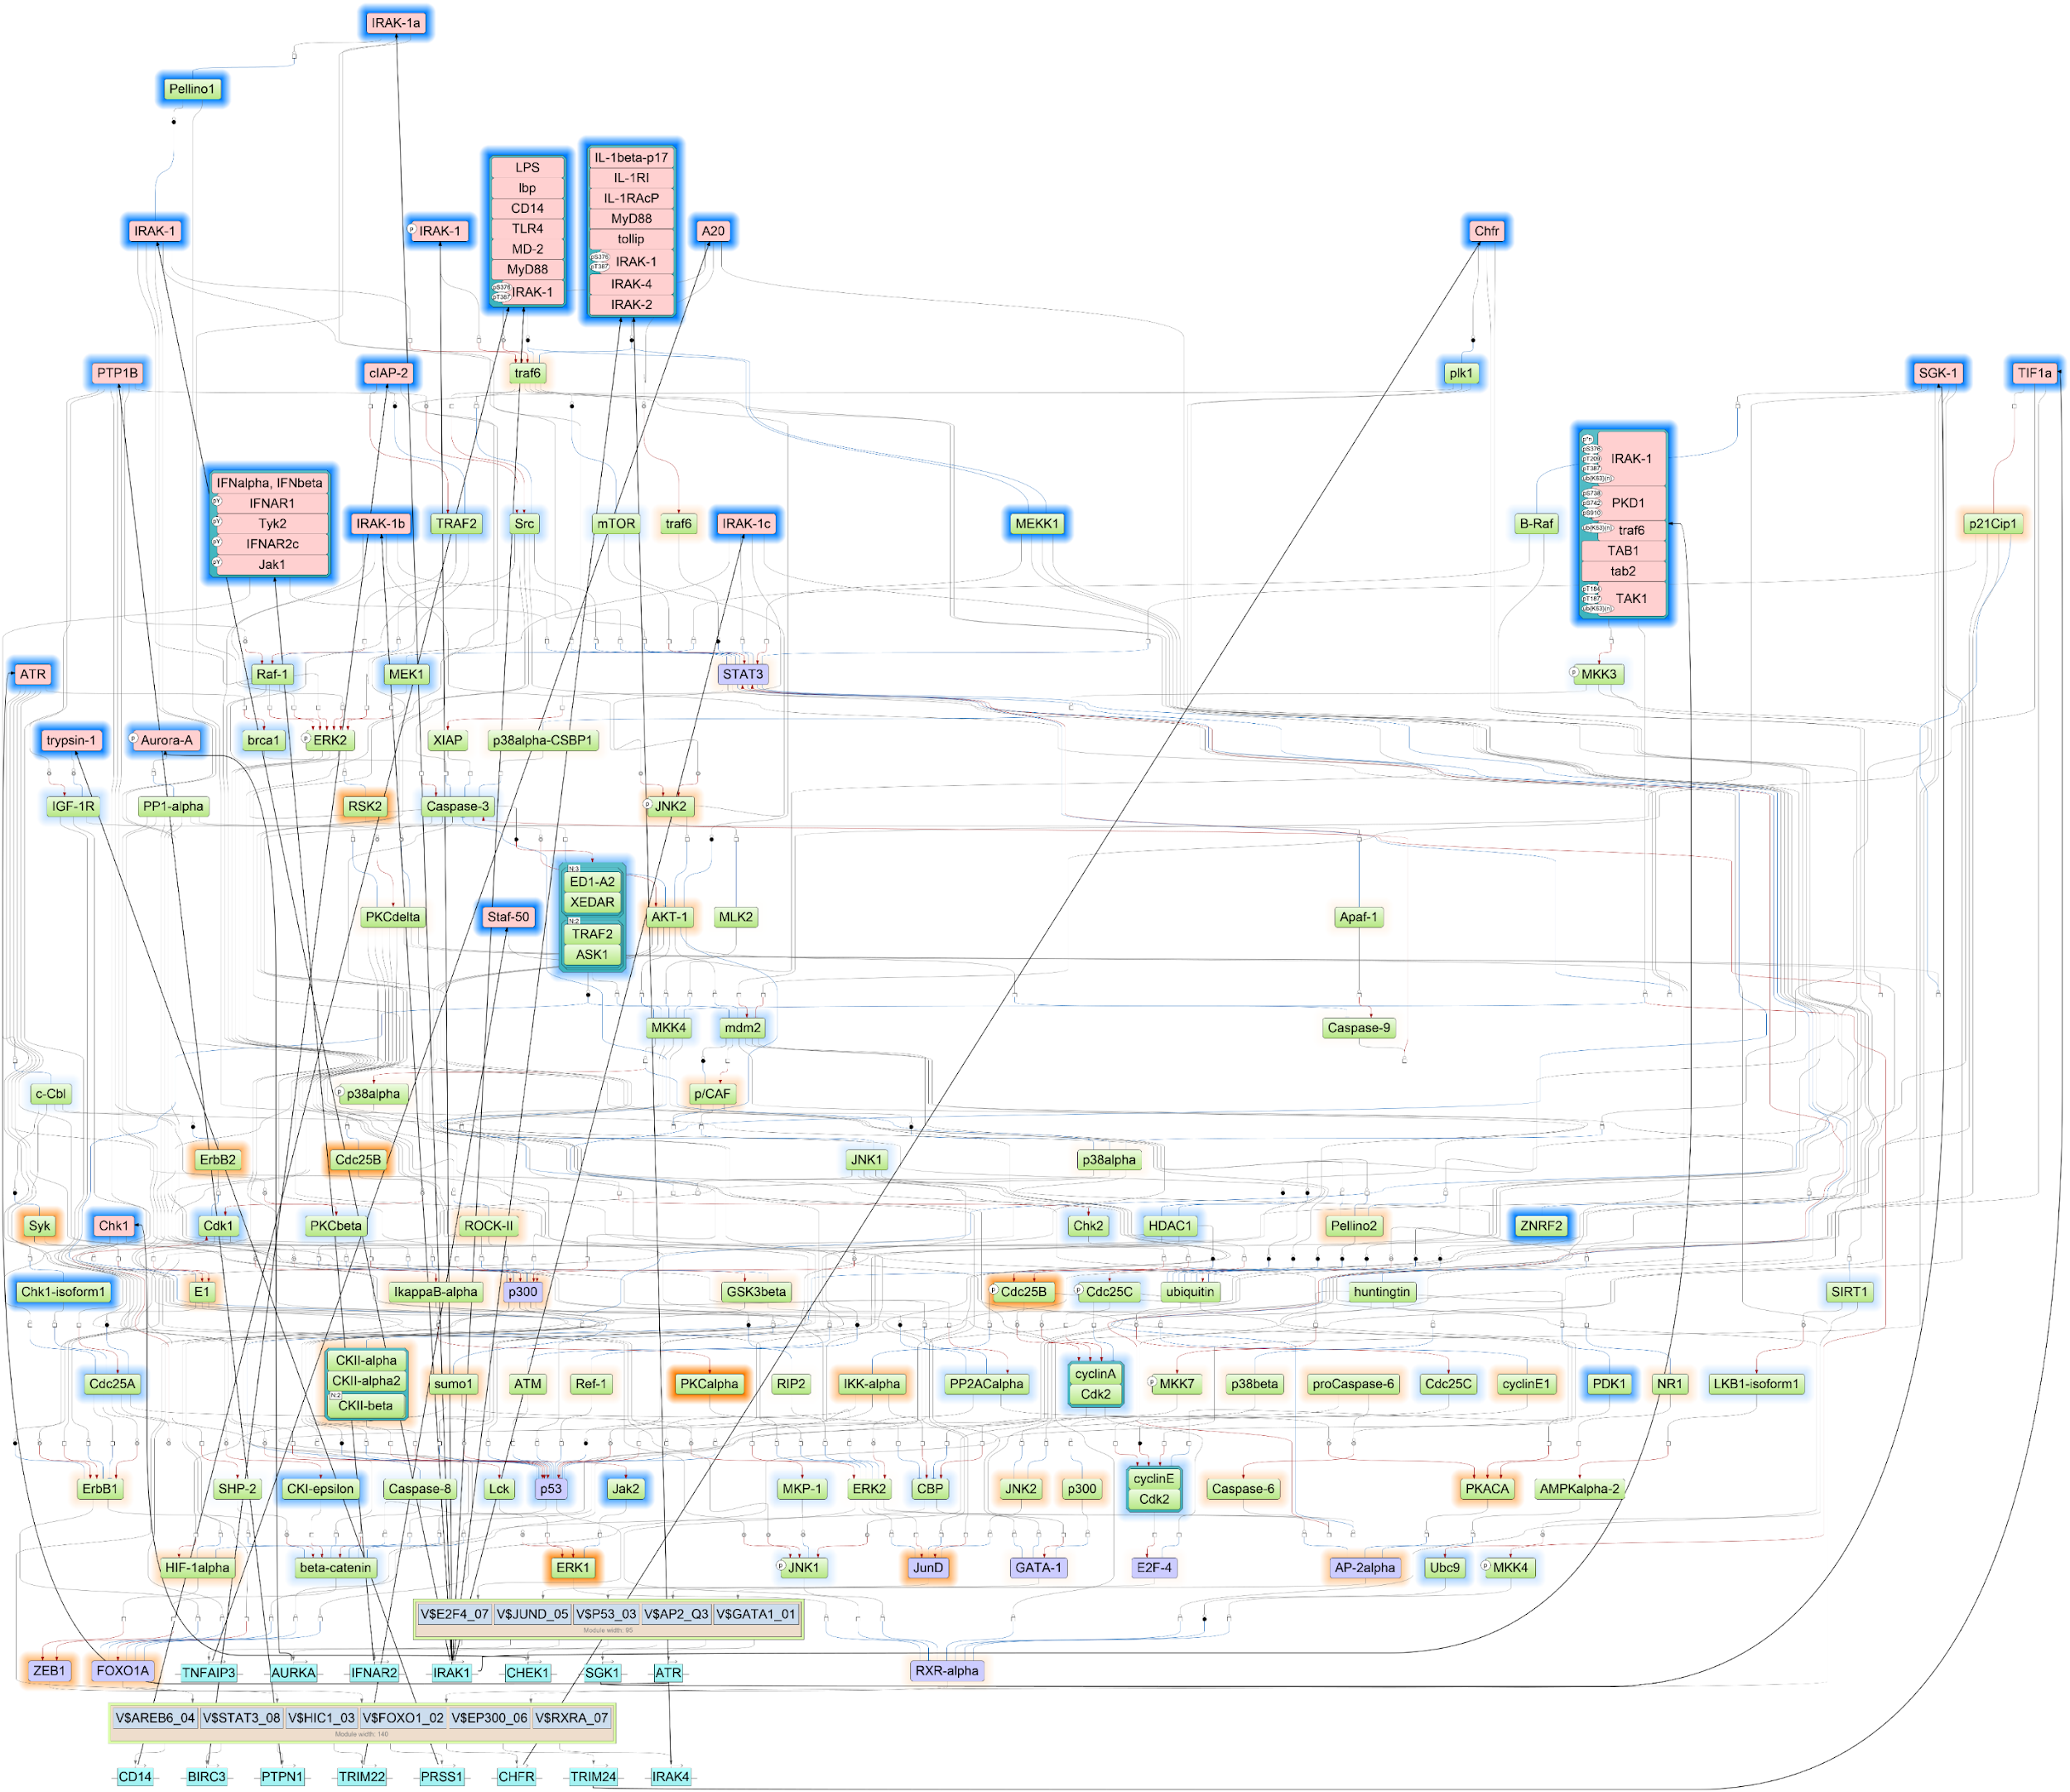
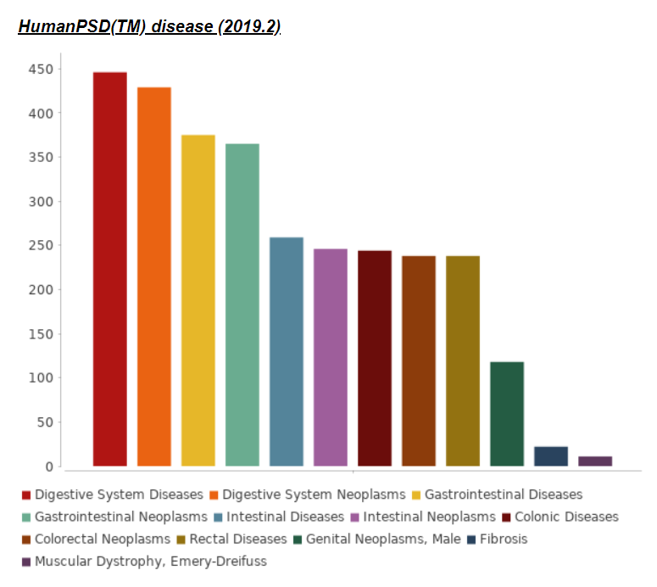
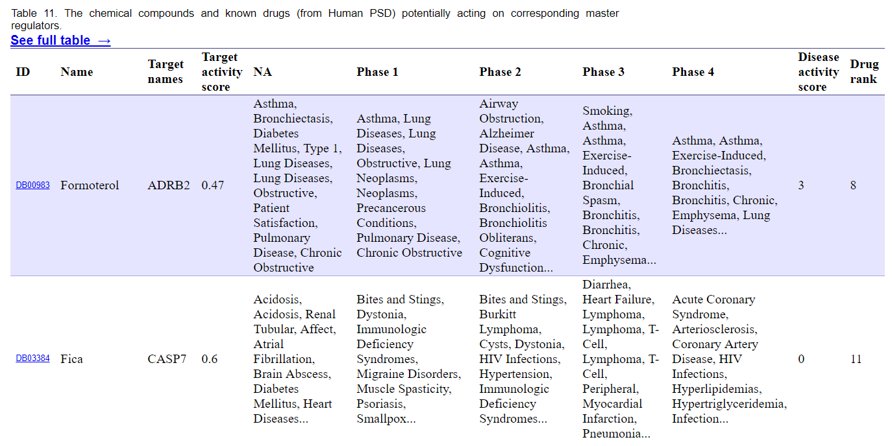
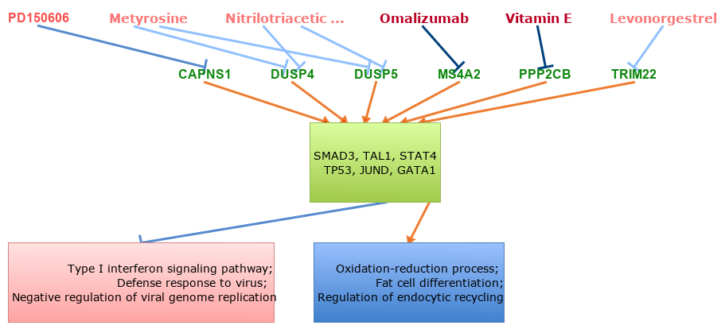
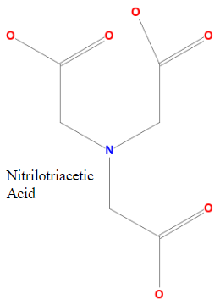
Key benefits
Genome Enhancer
Identifies activated targets in the examined patient data and selects the best fit therapy for every studied case
Issues a clear result in the form of a scientific paper
Suites for use by medical doctors and biologists
Does not require special skills
Processes all types of omics data
Easy data upload and annotation
One-click run
Generates a comprehensive report on identified drug targets and prospective therapies

Slide 16
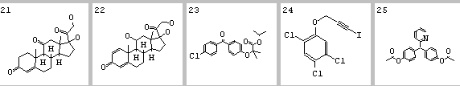
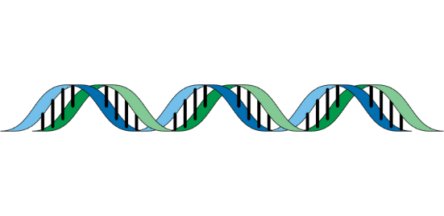
The workflow
Genome Enhancer
Genome Enhancer uses Upstream Analysis, an integrated promoter and pathway analysis, to identify potential drug targets for the studied pathology.
Upstream analysis schema
In the first step of this analysis the transcription factors that regulate differentially expressed or mutated genes are identified with the use of the TRANSFAC® database of transcription factors binding sites.
…
The second step searches for common master-regulators of the identified transcription factors by building a personalized signal transduction network of the studied pathology using the TRANSPATH® database of mammalian signal transduction and metabolic pathways.
Master regulators
The identified master regulators are prospective drug targets candidates and they are used for further selection of chemical compounds that can bring therapeutic benefit for the studied clinical case. In this step the HumanPSD™ database is employed to identify drugs that have been tested in clinical trials and PASS tool is used to perform cheminformatic analysis and predict small molecules that can affect the identified targets.
As the result of analysis a comprehensive report is generated.
Intermediate signaling molecules
Transcription factors
Genes
Genome

Slide 17
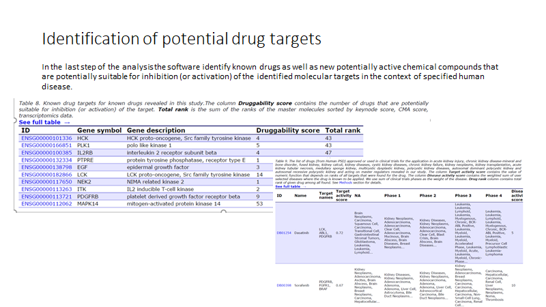

Slide 18
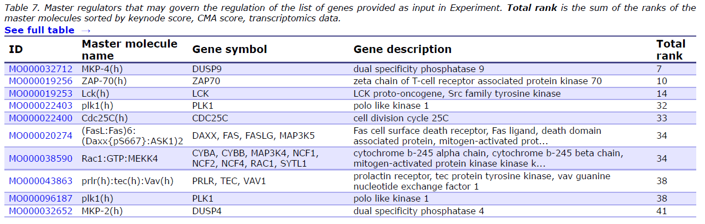

Slide 19
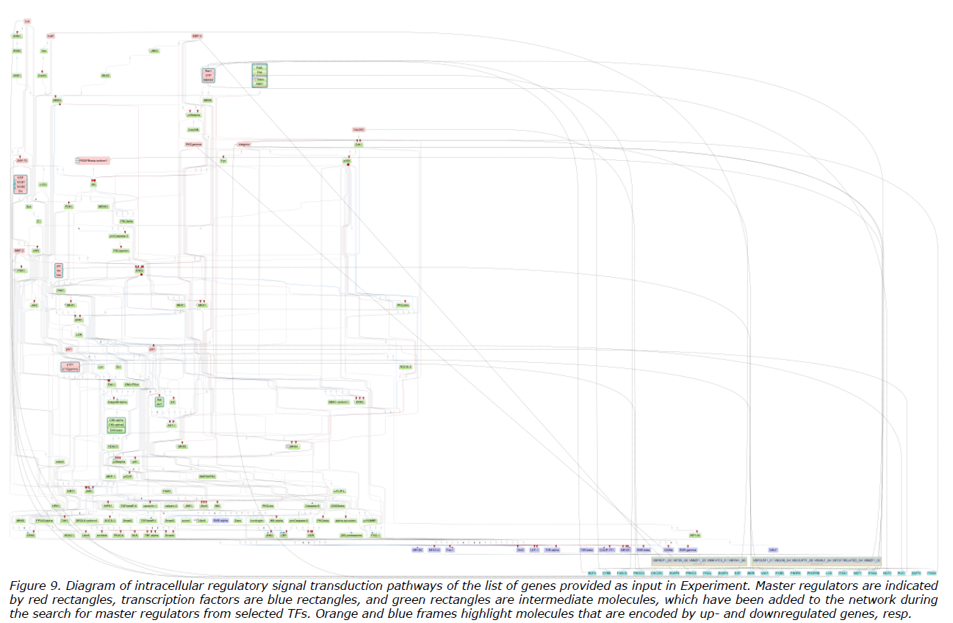

Slide 20
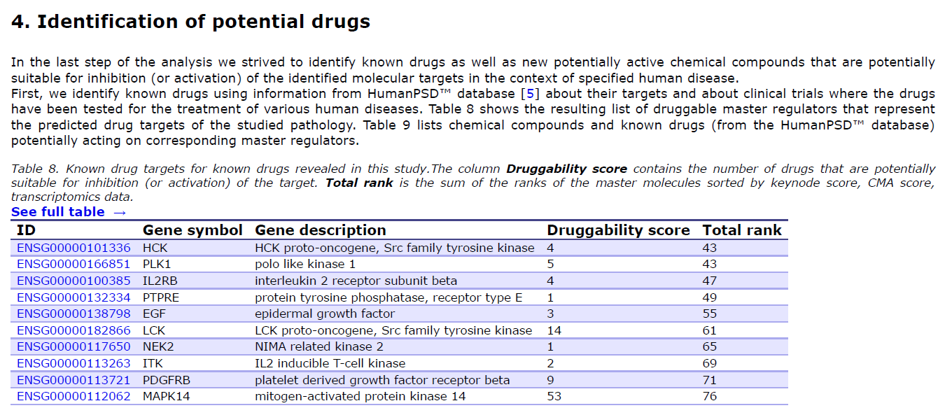

Slide 21
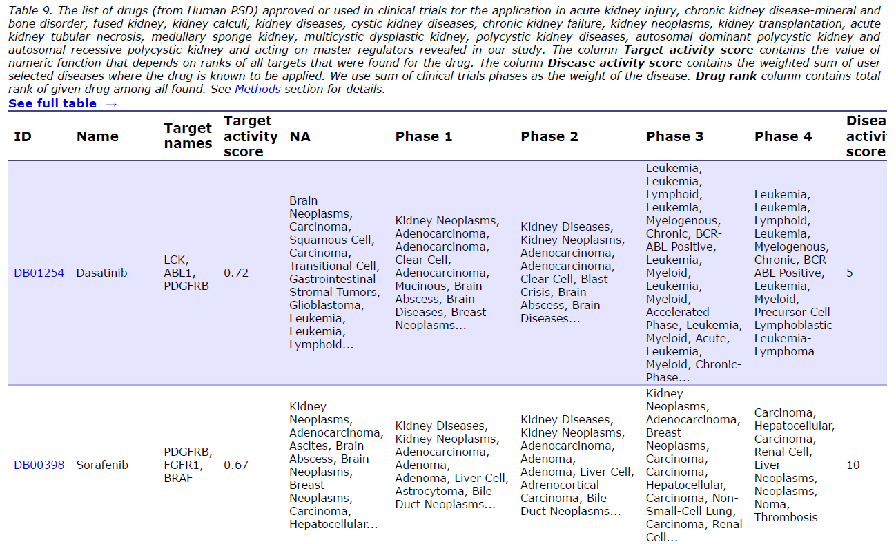

Slide 22
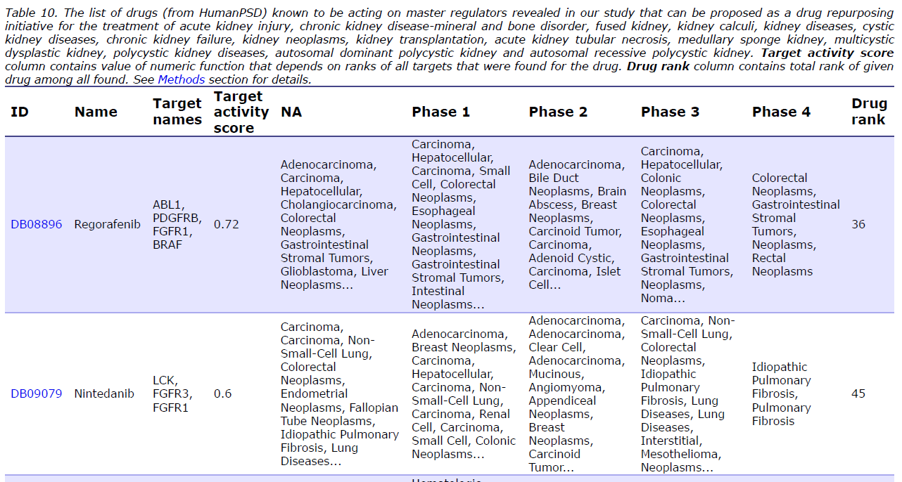

Slide 23
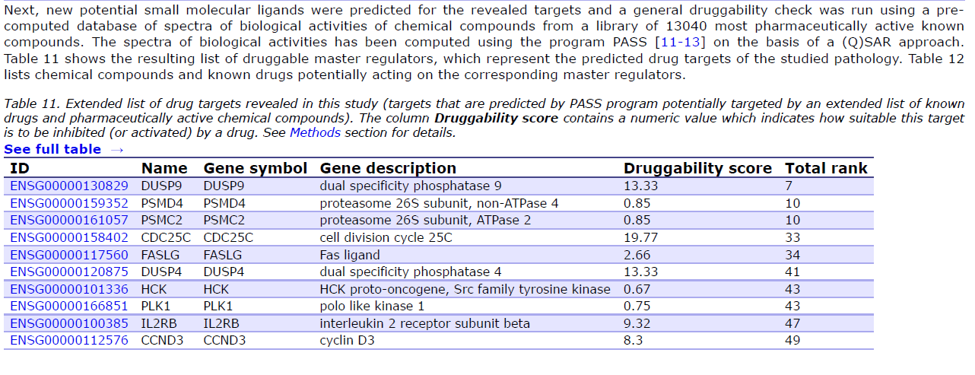

Slide 24
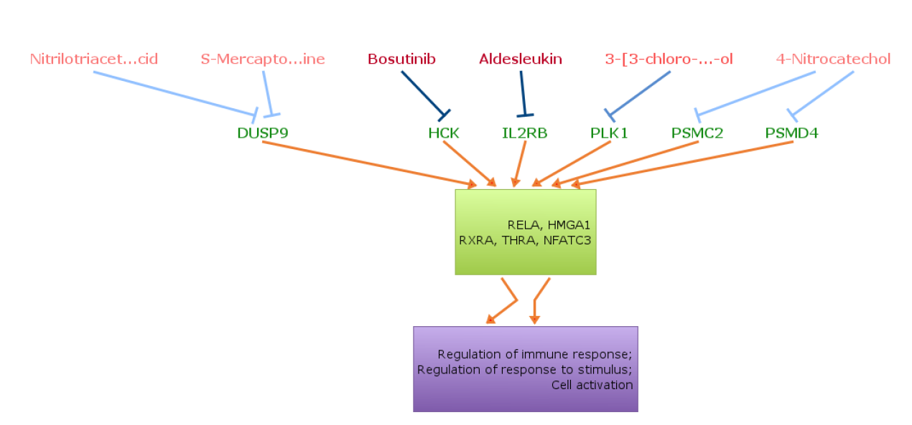

Slide 26
Workflow Diagram

